Slide 1
AUTONOMOUS DRONE DISASTER IDENTIFICATION AND ALERTING SYSTEM

Slide 2
PROBLEM STATEMENT
Drones will invariably fly into unusual situations and whether it’s swarms of bees, bird attacks, lightning strikes, or signal jammers, they will need to alert operators of problems as soon as they arise.

Slide 3
PROPOSED IDEA
Drones during flight will come across obstacles like trees, buildings, birds, airplane etc.,
Our Deep Learning model(CNN) will detect the obstacles if any.
Once the object is detected, Ultrasonic sensor with Pi is used to find the accurate distance of the object from the drone camera.
Using this , we are able to predict whether the obstacle is incoming or moving away from the drone (checking the distance in a recursive loop ).

Slide 4
PROPOSED IDEA (CONTD..)
Using Sound Alarm and SMS , an alert is sent to the operators once the obstacle is under drone’s vicinity.
Our model also tells whether the connection is lost between drone and control system/systems in case of jammers or any other physical disturbances of the drone.

Slide 5
TECHNOLOGY STACK
Deep Learning (CNN)
Open CV
Caffe Model (Fast processing )
Raspberry Pi
Ultrasonic sensor
Sinch messaging API
SMTP Server
Language - Python

Slide 6
WHY Ultrasonic sensor ?
High sensitivity
High frequency
High penetration power thus it is resistant to mist and dust
Transparent objects can also be detected since sound waves reflect back
Works on short range thus it helps the model to identify the obstacles only under drone’s field of view

Slide 7
WHY CNN ?
High Accuracy.
Less computational time.
More the number of layers , more the features extracted(deep CNN) .
Low-level features -> edges
Middle- level features –> blob like structures
High level features-> shapes

Slide 8
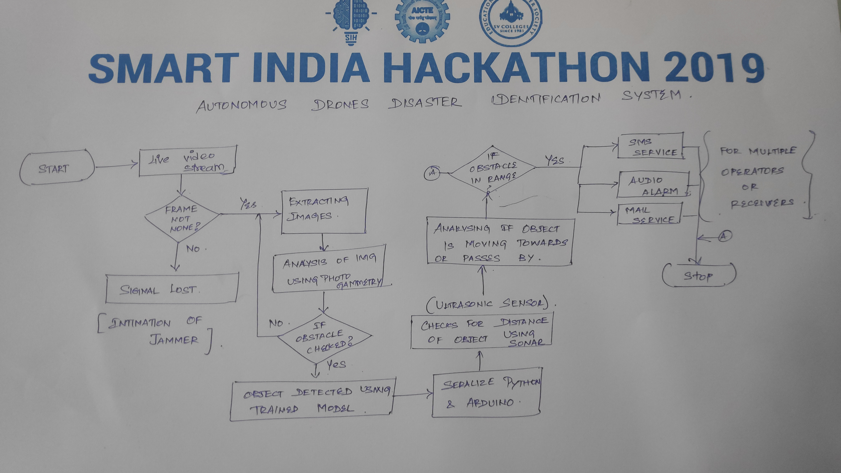
Project workflow

Slide 9
METHODOLOGY
Images from the drone live video is sent to the server.
Photogrammetry (Image analysis) is done and checks for the obstacles .
Our deep learning model predicts the presence of the obstacle and its type.
Using ultrasonic sensor , distance from the drone to the obstacles is calculated.
Using Pi , distance of the object in the live video can be obtained.

Slide 10
METHODOLOGY (CONTD..)
Check the distance of the detected obstacle using recursive loops
If the distance is in the vicinity range , it sends an alert to the operators.
Alert may be of SMS , email and sound alarm.
Our model also intimates about the loss of communication between the drone and the control system which might occur due to the presence of jammers.

Slide 11
SHOWSTOPPING FEATURES
The model predicts whether the obstacle is moving towards the drone or away from it (passing across it ).
More than one operators can be alerted if the situation demands.
Photo copies of the obstacles will be sent to the mail, which can be further generated as datasets. Thus developing an efficient model in future.
The model will also predict the multiple obstacles at a time. Hence object overlap constraints has been overcame.

Slide 12
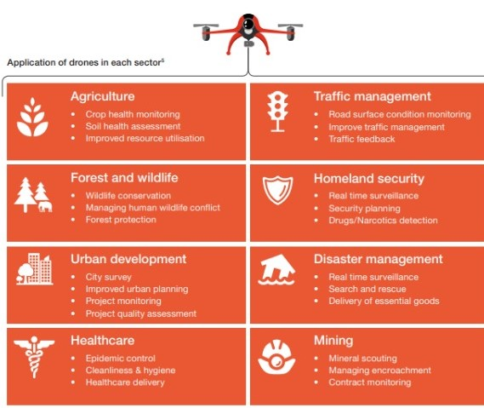

Slide 13
SOCIETAL IMPACTS
Predicting the obstacle for the drone during flight helps it to become more commercialized in the society.
Since the drone can identify person as obstacle, it can be further enhanced in the field of disaster hit areas to identify survivors and report them.
Military related drone will be resistant to obstacles in its path to achieve its main purpose of surveillance.

Slide 14
Societal impacts (contd..)
Current commercial drones have a significantly worse record for failure-free performance. For example, 15 percent of new micro-drones sold will fall within six months due to crashes (-FORBES) .
Using Our technique rate can be dropped to significant low level.

Slide 15
Thank you !!!

